Slide 1

A101 Science
Problem 14: Escaping Molecules
6th Presentation
Copyright © 2010

Slide 2
Comparison of Jasmine’s B-Box and William’s B-Box
Jasmine’s B-Box and William’s B-Box were exactly the same, except that their starting quantities of B molecules were different.
The greater the number of molecules present, the greater the number of molecules escaping from the B-Box.
Therefore in one minute, more molecules escaped from William’s B-Box compared to Jasmine’s B-Box.
Notes:
2

Slide 3
Rate of change of a quantity
The rate of change of a quantity describes how much the quantity changes per unit time.
For example, in our problem, the rate of change means a decrease of B molecules per unit time.
Time (min) | No. of B molecules escaped (millions)
0 | 0
1 | 40
2 | 38
Notes:
3

Slide 4
Rate of change of a quantity
In some cases, the rate of decrease (or increase) of the quantity remained constant with time,
Example 1
However, the rate of decrease (or increase) of the quantity may also change over time.
  - An example is when the rate of change in quantity is proportional to the quantity present, Example 2
Notes:
4

Slide 5
Example 1 –
Rate of decrease remains constant
For Mary’s B-Box, the G-Goblin kept eating the same number of molecules every minute until all molecules were consumed. In this process, the rate of decrease remained constant.
Notes:
5

Slide 6
Rate of change of a quantity
In some cases, the rate of decrease (or increase) of the quantity remained constant with time,
Example 1
However, the rate of decrease (or increase) of the quantity may also change over time.
  - An example is when the rate of change in quantity is proportional to the quantity present, Example 2
Notes:
6

Slide 7
Example 2 –
Rate of decrease changes over time
For the B-Boxes with a fixed hole, the quantity of the molecules keep decreasing.
As the rate of decrease was proportional to the number of molecules present, the number of molecules escaping each minute decreases.
The proportion of molecules that escape in any minute remains the same.
Notes:
7
Check for the proportion should be 0.05

Slide 8
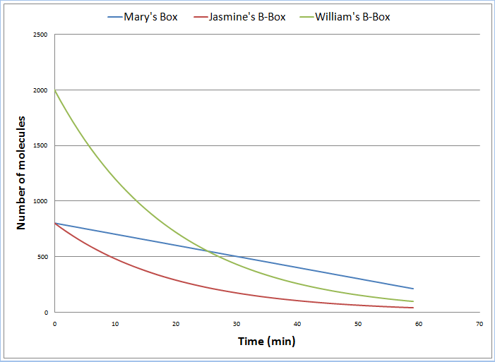
Comparison
Mary’s Box - rate of decrease remained constant over time
Jasmine and William’s Box - rate of decrease changed over time
Notes:
8

Slide 9
Exponential Relationship
The molecules escaping from the B-Boxes and radioactive decay are both examples of exponential decrease.
However, not all cases will bring about exponential decrease. Sometimes, for instance, the bank deposit, it is an exponential increase instead.
A distinct characteristic of exponential relationship is that at every point in time, the rate at which the quantity decreases/increases is proportional to the quantity present.
Notes:
9

Slide 10
Exponential Relationship
The following quantity-time curve shows the exponential decay of a radioactive substance . Notice the characteristic shape of the graph.
quantity drops by half of original amount
Quantity
13.5 min
quantity drops by half of original amount again
13.5 min
quantity drops by half of original amount again
13.5 min
Time
The time taken for a quantity to decrease by a fixed percentage is the same.
Notes:
10

Slide 11
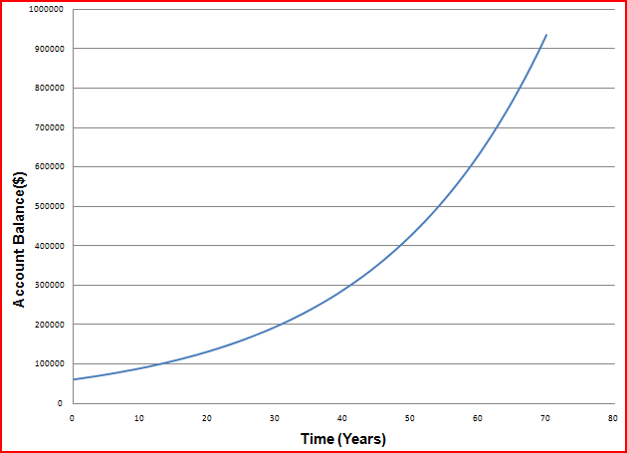
Going further – Bank Account
At every point in time, the rate at which the account balance increases is proportional to the account balance.
The time taken by David’s bank balance to increase by a certain percentage (say 10%) is constant.
Notes:
11

Slide 12
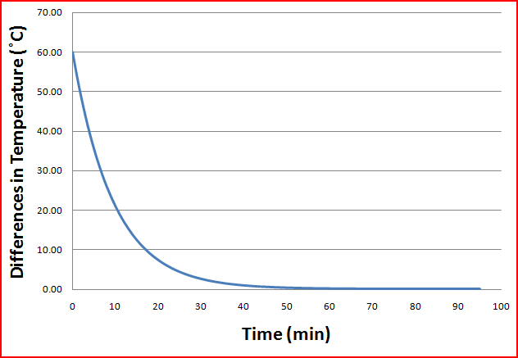
Going further – Cooling of Coffee
The temperature difference between the coffee and its surroundings with time exhibits the behaviour of an exponential decay.
Notes:
12

Slide 13
Learning points
When the rate of decrease/increase of a quantity is proportional to the amount present, it is an example of exponential relationship.
Other characteristics of an exponential relationship include:
  The time taken for the quantity to decrease/increase by a fixed percentage is constant.
  The slope of the quantity versus time graph gets gentler over time for an exponential decay.
Notes:
13

Slide 14
Discussion
In a town, a person contracted an unknown, highly contagious disease. It was estimated that on the average, one infected person was able to pass this disease to five other people everyday. Currently there is no cure for the disease.
Does the number of people who contracted the disease in the town increase at an exponential rate? Why?
Notes:
14

