Slide 1

A101 Science
Problem 12: My Parents and I
6th Presentation
Copyright © 2010

Slide 2
Inheritance of traits
It is commonly observed that children bear some resemblance to their parents.
The passing on of inherited materials from parents to their offspring partially accounts for such observations.
The study of the inheritance of traits in pea plants by a monk, Mendel, explains how inherited materials are passed on from parents to their offspring.

Slide 3
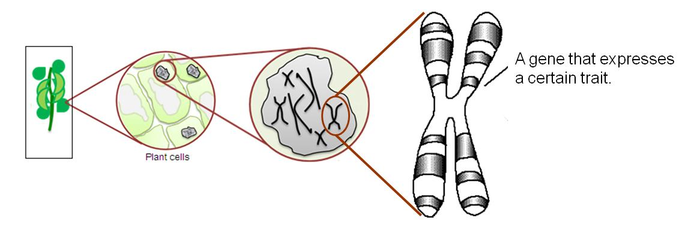
The hidden information
These inherited materials are the chromosomes found in the nucleus of a cell.
The portion of the chromosomes that controls a certain trait, for example the colour of pods, is known as a gene.
a gene that controls a certain trait
plant cells
nucleus
a chromosome

Slide 4
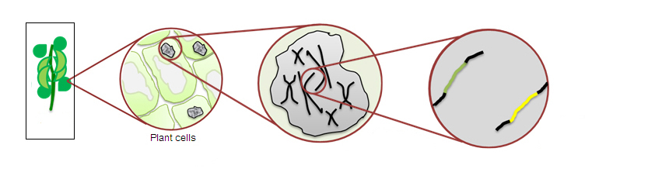
The hidden information
  Genes can have more than one form.
  For example, the gene that controls the colour of the pods can have a form that produces yellow pods and another that produces green pods.
  Different forms of the same gene are called alleles.
  However, even if the allele for yellow pods is present, the offspring may not have yellow pods.
Two different forms of the gene that affects the colour of pods in the pea plants.
Allele for green pods
Allele for yellow pods
plant cells
nucleus

Slide 5


Observations and deductions
Plant type: Green_1
green pods
Plant type: Yellow
yellow pods
Traits of Parent plants
Alleles Present in Parent Plants
Traits of Offspring Plants
Alleles Present in Offspring Plants
Breed
×
All green pods
Green trait of the pod is expressed instead of yellow. Why?
Offspring must contain inherited materials from each parent.
The allele that produces green pods dominates the allele that produces yellow pods in the pea plants.
NB. Usually, we denote the bars as alphabets

Slide 6
Observations and deductions
Based on the traits of Green_2 Parent plants, the possible allele(s) present are
Traits of Parent Plants
Alleles Present in Parent plants
Traits of Offspring Plants
Alleles Present in Offspring Plants
Plant type: Green_2
green pods
Plant type: Green_2
green pods
Breed
×
Or
Offspring must contain inherited materials from each parent.
3 Green : 1 Yellow

Slide 7
Effect of the alleles on traits
Traits of Parent Plants
Alleles Present in Parent Plants
Trait of Offspring Plants
Alleles Present in the Offspring Plants
Effects of the Alleles on Traits
Green_1
green pods
Yellow
yellow pods
Green_2
green pods
Green_2
green pods
Breed
Breed
×
×
All green pods
3 green pods: 1 yellow pods
  The combined effect of the two forms of gene that are inherited by the offspring determines the traits that will be expressed.
The allele that produces green pods dominates the allele that produces yellow pods.
The allele that produces yellow pods will only be expressed in the absence of the dominant form.
Therefore, the allele that produces green pods is dominant while the allele that produces yellow pods is recessive.

Slide 8
Jonathan’s Case
Jonathan shows a trait which his parents do not exhibit. Hence, the allele for sickle cell anaemia must be recessive.
Jonathan had inherited:
His parents must have the following :
Possible forms of genes inherited by their children:
Jonathan’s siblings have 75% chance of not getting the disease. However, there is a 50% chance that they are carriers of the disease.
Legend:
Normal form of gene
Allele that causes the disease
Father Mother

Slide 9
Expression of intermediate trait
Red flowers Yellow flowers
All with orange flowers
Parents:
Breed
Offspring:
×
RR YY
RY
In this case, although the allele for red flowers and the allele for yellow flowers are expressed, the offspring has an intermediate flower colour.
Both alleles are not fully dominant over each other resulting in an intermediate trait.

Slide 10
Expression of both dominant traits
Traits of David’s parents
Forms of gene present in parent
Traits of children
Forms of gene present in children
Father
Blood Type A
Mother
Blood Type
B
Possible alleles present in parents
×
Father
AA
Mother
AO
BO
BB
1:1:1:1
Blood Types
For David’s blood to be O, alleles for blood type O must be present in each parent.
AB
AO
BO
OO
It is possible for parents with blood types A and B to have blood type O children.
All blood types are possible for David’s siblings.

Slide 11
Going Further
Traits of the animal
Forms of gene present
Traits of offspring
Forms of gene present in children
Mixture of white and red fur
Mixture of white and red fur
×
RW
RW
Fur Colours
NB: Both red and white furs are dominant traits
Mixture of red and white
Mixture of red and white
Red
White
RR
RW
WR
WW
The offspring can have red, white or a mixture of red and white fur
colour.

Slide 12
Learning points
Based on Mendel’s observations of pea plants, certain traits are passed on from parents to offspring as a result of the passing on of two sets of inherited material, one set from each parent.
The traits of the offspring can emerge from the inherited materials in different ways:
  The effect of one allele of a pair is expressed in the offspring in preference to the other. (E.g. allele for green pod dominating over allele for yellow pod in the pea plants).
  The expression of an intermediate trait in the offspring when one allele of a pair is not fully dominating over the other. (E.g. interaction of the allele for red flower and that for yellow flower gives rise to offspring with orange flowers).
  Both sets of inherited materials are dominant and are expressed simultaneously. (E.g. blood type AB is a result of the presence of an allele for type A and an allele for type B).

Slide 13
Discussion
A particular species of animal can have either brown or grey fur.
An animal with brown fur has either the alleles “BB” or “BG” for fur colour.
An individual animal with grey fur can only have alleles “GG” for fur colour.
The breeding of two parents gives rise to some offspring with brown fur and some offspring with grey fur.
Deduce all the possible pairs of alleles for fur colour of each parent. Justify your answers.

Slide 14
Further reading
For more information on the topic relating to this problem, read up the following sections in the link http://library.thinkquest.org/20465/peaexp.html.
  Pea Plants
  Mendel’s Laws
  Genes: Recessive Genes, Dominant Genes, Incomplete Dominance and Co-dominance

