Slide 1
A101 Science
Problem 11: It’s Not Just a Bag!
6th Presentation
Copyright © 2010

Slide 2
Functions of the cell membrane
The cell membrane has certain functions which support the activities of the cell.
Functions of the cell membrane | Related activities of a cell
Able to act as a barrier (separate the interior and exterior environments of the cell and hold the cell contents in) | Maintain suitable environment for cell to carry out various activities (e.g. manufacturing processes)
Able to allow selected exchanges between the interior and exterior of the cell | Take in raw materials and give out waste materials (e.g. manufacturing processes, metabolism)
Able to change its shape and size when required | Reproduce and move

Slide 3
What if the membrane was made up of the following materials?
Requirements of the cell membrane
Rigid, impermeable container
Sealed,
impermeable
bag
A single-layered, porous cloth-like sheet
Holds cell contents
✓
✓
✓
Depending on size of contents
Allows exchange of materials (e.g. entry of glucose, or exit of CO₂ from the cell)
✗
✗
✓
Selective transport of substances
✗
✗
✗
Selectivity is based on size only
Flexibility (e.g. for cell division and cell movement)
✗
✓
✓
Spontaneous breaking and resealing (e.g. for cell division and ‘eating’ of large substances by cell)
✗
✗
✗
Other remarks
Maintains fixed volume and shape
--
--

Slide 4


Basic material of the cell membrane
The basic material that makes up the cell membrane is a phospholipid molecule as shown in the diagram below.
Non-Polar region:
All non polar bonds
(i.e. C-C and
C-H bonds)
Head
Polar region:
Presence of polar bonds (E.g. C=O bonds) resulting in a net dipole
moment
Ability to interact well with other polar substances (E.g. water)
Polar
Tail
Non-Polar
Diagrammatic representation
General chemical structure

Slide 5
Self-assembly of phospholipids
Adding phospholipids molecules to an aqueous medium like water can result in a single layer of phospholipids molecules on the medium’s surface.
The polar head of phospholipids are immersed in the medium, while their non-polar tails are excluded from it as polar - polar interactions are more favourable.
Aqueous Medium

Slide 6
Self-assembly of phospholipids
A phospholipid bilayer will be formed if more phospholipids molecules are added, followed by more aqueous medium. This bilayer forms a boundary between two aqueous regions (e.g. the interior of a cell and its environment).
Aqueous Medium

Slide 7
Flexibility of phospholipid membranes
Because phosopholipid membranes are made of subunits, they can change in size by adding and removing subunits.
The relatively weak interactions between phospholipid molecules allow the membrane to be interrupted and reformed when necessary. It also allows the membrane to be flexible.

Slide 8
Effect of kinks
Phospholipid molecules without kinks
The double bond between carbon atoms in the non-polar tail of the phospholipid molecule results in the “kink”.
This increases the spacing between molecules and increases the membrane permeability.

Slide 9
Permeability of phospholipid bilayer
Large molecule (polar or non-polar)
Small molecule (polar or non-polar)
Cell Exterior
Cell Interior

Slide 10
Permeability of phospholipid bilayer
Cell Exterior
Cell Interior

Slide 11
The natural cell membrane- its enhancement
Although the semi-permeable nature of the cell membrane prevents some toxins from entering the cell, some substances that are essential to the survival of the cell are also blocked.
The cell membrane thus includes molecules that allow these essential substances to be transported through the cell membrane.
The type of transport for each substance depends on the following factors,
-Size of the substance
-Polarity of the substance
-The concentrations of the substance to be maintained inside and outside the cell

Slide 12
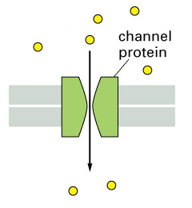
Cell Membrane transport
Type of Transporter | General Properties | Example
Passive membrane transporter | No energy required (i.e. allows molecules to move from higher to lower concentration) | Channel Mediated transport
Notes:
Image adapted from :
http://www.accessexcellence.org/RC/VL/GG/ecb/comparison_active_passive_transport.php

Slide 13
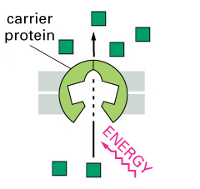
Cell Membrane transport
Type of Transporter | General Properties | Example
Active membrane transporter | Requires energy to drive the transport of substance (i.e. allows molecules to move from lower to higher concentration) | Active transport via carrier proteins
Notes:
Image adapted from :
http://www.accessexcellence.org/RC/VL/GG/ecb/comparison_active_passive_transport.php

Slide 14
The natural cell membrane- its enhancement
Substance | Characteristics (polarity, size) | Relative Concentration |  |  | Type of Transport | Transporter required?
 |  | Outside the cell | Inside the cell | Required in Cell
Oxygen | Non polar, small | High | Low | High | Passive | No
Sodium Ions | Charged, small | High | Low | Low | Active | Yes
Glucose (C₆H₁₂O₆) | Polar, large | Low | High | High | Active | Yes
Represents the general concentration gradient under normal circumstances
Fixed based on substance concentration gradient and requirements of the cell under normal circumstances
Note: Water is a small polar molecule. The relative amount of water inside and outside of a cells varies under different situations. Cell membranes use passive transporters to allow water to move freely in and out of the cell.
Notes:
Note for glucose:
There are more than one type of transport molecules for glucose.
The example of glucose in the table represents a possible scenario for a cell in our intestines. The active transport of glucose into such cells enable the efficient absorption of glucose from the digested food into the body.
Otherwise, in most other cells in our body, the concentration of glucose outside the cell will always be higher than that inside the cell. This is because once the glucose enters the cell, it converts into other forms and, consequentially, the glucose concentration inside the cells is kept low. In addition, the glucose concentration outside the cells are normally controlled to be kept higher. In these cases, the transport of glucose into cells is via facilitated transport (passive).

Slide 15
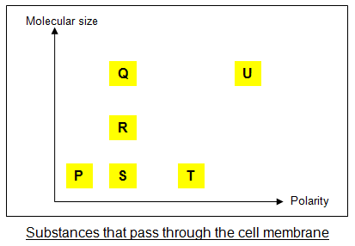
Going Further
Small molecules pass through the gaps between the phospholipid molecules easily.
The membrane allows non polar molecules to pass through more easily than polar ones.
R has a larger molecular size than S, while T is more polar but smaller than Q and R. There is insufficient information to conclude whether molecular size or polarity has a greater impact on how easily a molecule can pass through the cell membrane.
R passes through the membrane more easily than Q.
Ease of passing through the membrane:
Easiest P
S
R
Q
Most difficult U
T (in no particular order)

Slide 16
Learning points
A living cell needs to perform many activities, which typically include obtaining nutrients and removing waste, undergoing cell division, etc.
The structure and composition of the cell membrane allows it to meet these demands.
  It is made up of phospholipid molecules which spontaneously assemble into a bilayer. This bilayer is:
    Flexible,
    Able to change size easily and
    Selectively permeable to materials, depending on their polarity and size.
  It has molecules embedded in the phospholipid bilayer that carry out specific functions such as allowing passive diffusion or active transport of materials.
Notes:
16

Slide 17
Discussion
Discuss whether the following modified phospholipid molecules may be used to form a cell membrane.
Molecule A
Molecule B
Molecule C
Molecule D

