Slide 1
A101 Science
Problem 10: Life in a Cell
6th Presentation

Slide 2
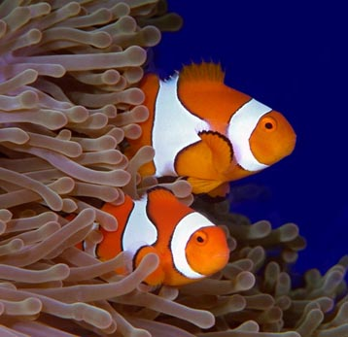
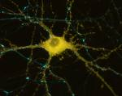

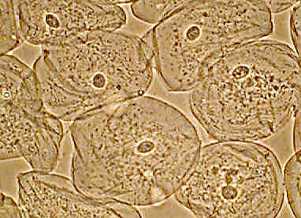
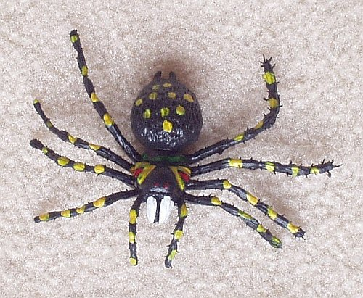
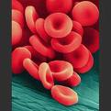
Living things are made up of cells
Cells are the building blocks of all living things.

Slide 3
An overview: the activities of the cell
Different types of cells carry out some common activities that ensure the survival of the cell.
Produce new materials
Produce energy
“Eat”, “drink” and “get rid of waste”
Control activities
“Grow”

Slide 4
The way cell “Grows”
Most cells “grow” by:
  first increasing in size and
  then dividing into two new identical cells.
This way of “growing” is also known as mitosis.
Stage 1
Stage 2
Stage 3

Slide 5
The importance for cells to “Grow”
For example, when a cell dies, another identical cell is produced and replaced the dead cell.
Thus, this activity enables the living thing to grow in size as well as to recover when injured.
Cells divide into two
Cell dies!
Dead cell is replaced

Slide 6
Role of DNA for cell to “grow”
As the new cell has to function in the same way as the dead cell, there is a need to produce new cells that are identical.
Therefore, the cell contains a set of “instructions”, also known as the DNA (deoxyribonucleic acid) that tells the cell exactly how to produce new cells.
Due to the importance of the DNA, DNA is:
  Specially placed in a compartment within the cell. This compartment is known as the nucleus.
  Copied during mitosis so that the new cell will have the exact same set of “instructions” as the original cell.
DNA in nucleus
The nuclei of both cells contain the same DNA

Slide 7
The “eating”, “drinking” and “getting rid of waste”
The cell needs to take in materials required for its survival.
  For example, when a cell forms new structures for mitosis, the cell needs to take in the raw materials needed.
The cell needs to remove toxic waste materials produce by its activities.
Hence, the “skin” of a cell, also known as the cell membrane, is selectively permeable (allows certain things to pass through but blocks others).
Material from food processed by the body
Cell Membrane
Waste material
Other materials not needed by cell

Slide 8
The “production” of energy
Energy is required by the different activities in the cell.
A cell’s energy comes from the food that is taken in by the living thing.
  the food is digested by a series of chemical reactions to break it down
  the cell in the body “eats” the digested food (mainly glucose for energy production).
  the energy from the digested food is being transferred to the bonds of adenosine triphosphate (ATP) at the “power generators” (also known as mitochondria) of a cell.
Cell “eats” glucose
Mitochondria transfer energy to bonds of ATP
Food digested

Slide 9
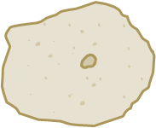
The “production” of energy
In every cell, many mitochondria are scattered all around to provide sufficient ATP molecules to provide energy for the activities carried out at different locations of the cell.
ATP molecules work like rechargeable batteries:
  When the cell needs energy, the mitochondria produce energy from “food” that the cell “eats”.
  The energy produced is stored temporarily in ATP molecules.
  ATP molecules carry the energy that is used directly by the cell components and for the cell activities.
  When the energy in ATP molecules is used, the used ATP molecules can be “recharged” with energy at the mitochondria.
Legend:
“Power generator”:

Slide 10
The production and packaging of new materials
The cell constantly needs to replace damaged components and produce new materials in preparation for mitosis.
In the nucleus, the “instructions” from the DNA are copied onto a “messenger” for the production of the new material.
The “messenger”, containing the copied “instructions”, moves out of the nucleus to the “factory” of the cell.
The new material is made as the “factory” of the cell reads the copied “instructions” of the “messenger” and assembles its raw materials.
Lastly, the new material is sent to the “postal office” of the cell to package and tag it with an “address” for safe delivery to the correct location.

Slide 11
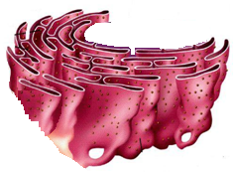
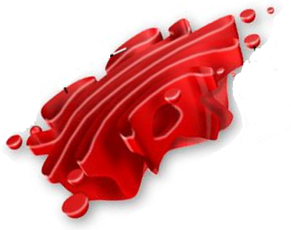
The production and packaging of new materials
New materials are produced at the ribosomes found on the rough endoplasmic reticulum. This is analogous to manufacturing in factories.
The “postal office” of the cell is the golgi apparatus.
Ribosomes on the Rough Endoplasmic reticulum
Golgi Apparatus

Slide 12
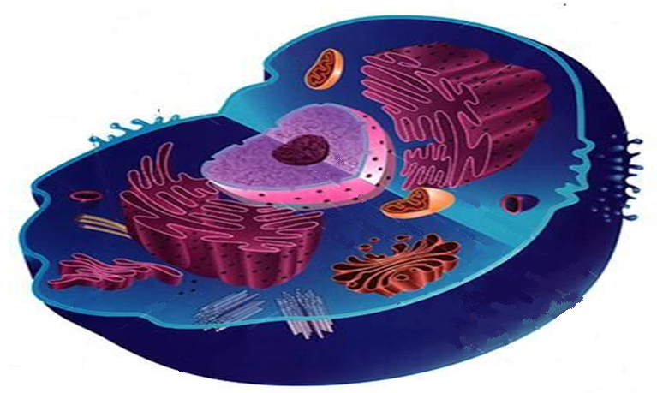
Same basic components in different cells enable them to carry out the same activities for survival
Produce energy (ATP)
Produce and package new materials
“Eat”, “drink” and “get rid of waste”
Mitochondria
Cell Membrane
Ribosomes and Rough endoplasmic reticulum
DNA in Nucleus
Golgi apparatus
“Grow”
Control activities
Involve all basic components in the cell

Slide 13
Self-management of activities
Activities within the cell must be regulated and monitored so that conditions in the cell and the living thing do not fluctuate beyond what is beneficial for the survival of the cell and the living thing.
For example, the cell needs to be able to control its own “eating” of glucose so that it will have enough glucose to produce energy for its activities.
This ability to control its activities also enables cells to be self managing.

Slide 14
Other factors affecting the cell’s activities
Other cells in the living thing can also influence a cell’s activities. Thus, cells in a living thing are interdependent and do not operate in isolation from other cells.
For example, certain cells in our pancreas can sense the glucose level in our blood and influence the “eating” of glucose in our muscle cells.
The external environment and the living thing can also influence the cell’s activities, but mostly indirectly and not on any individual cell directly.
For example, when the surrounding temperature becomes too warm for our body, our cells start to produce sweat to help us lose heat energy.
Notes:
For example:
When a particular type of cells in the pancreas sense a high glucose level in the blood (indicative of food intake), these cells are triggered to release insulin, a hormone that “tells” other cells in our body to “eat” up the glucose.
When there is a wound on the skin, the surrounding cells near the wound “signals” to white blood cells, which are patrolling in the blood stream, to defend against invading bacteria or viruses at the wound.

Slide 15
Learning points
The cells are the basic unit of living things. They are self-managing, but do work together with other cells at the same time.
Activities that ensure a cell’s survival include:
  Cell growth (Mitosis)
  Exchange of materials across the cell membrane
  Produce energy
  Produce and package new materials
  Control of the above activities
Different cells can carry out the same basic activities because all of them have the same basic components that are responsible for these activities.

Slide 16
Discussion
A type of cell has been found to carry out many production processes which involve the manufacture of substances that are transported out of the cell.
Explain how the components of such a cell would differ from a muscle cell.

