Slide 1

A101 Science
Problem 08: Who is Right
6th Presentation
Copyright © 2010

Slide 2
The Study of Motion
In describing the motion of objects, the following terms are often used:
      Displacement
      Velocity
      Acceleration
For better analysis of motion, displacement, velocity and acceleration can be plotted against time on graphs respectively

Slide 3
Directional and non-directional quantities
Scalars are quantities that only have magnitude.
E.g. Speed, Mass, Distance, Time
Vectors are quantities that have both magnitude and direction.
E.g. Velocity, Weight, Displacement, Acceleration
The common convention is to treat vector quantity in the right direction as positive and that in the left direction as negative.
E.g. a car travelling at 2 m/s is said to be travelling towards the right while a car travelling at −2 m/s is said to be travelling towards the left.
(Note: Although this is a common convention, it is also possible to take vector quantity in the left direction as positive and vice versa.)

Slide 4


Displacement
Displacement measures the distance and direction of an object with respect to a reference point.
This measures how far the object is with reference to a reference point, and may or may not be the same as the distance travelled by the object.
If we take this direction to be positive,
10 m
13 m
Displacement = −3 m
Distance travelled = 23 m
Negative sign indicates that the car is on the opposite side of the reference point

Slide 5
Velocity
Average velocity is defined as the rate of change of displacement, i.e. the change in displacement in a time interval divided by the time taken during the interval.
Suppose the current displacement of a car from a house is 300 km, and the car travels at a constant velocity of −50 km/h.
If we take this direction to be positive,
300 km
50 km/h

Slide 6
Velocity
Average velocity is defined as the rate of change of displacement, i.e. the change in displacement in a time interval divided by the time taken during the interval.
Suppose the current displacement of a car from a house is 300 km, and the car travels at a constant velocity of −50 km/h.
If we take this direction to be positive,
After 2 hours, the final displacement would be
300 km + (2 h × -50 km/h) = 200 km.
200 km
50 km/h

Slide 7
Graphs: Velocity to Displacement
For constant positive velocity against time graphs,
Change in displacement = Velocity × Time
    = Area under the graph
Given any graph of how velocity varies with time, the area under the graph will represent the change in displacement from time t₁ to time t₂.
If the initial displacement at time t₁ is 20 m, the displacement at t₂ will be (20 + area under graph) m.
v (m/s)
Area under the graph gives change in displacement from time t₁ to time t₂.
In this case, the displacement is positive.
t (s)
0
t₁
t₂

Slide 8
Graphs: Velocity to Displacement
For constant negative velocity against time graphs,
Change in displacement = Velocity × Time
    = Area under the graph
Given any graph of how velocity varies with time, the area under the graph will represent the change in displacement from time t₁ to time t₂.
If the initial displacement at time t₁ is 20 m, the displacement at t₂ will be (20 − area under graph) m.
v (s)
t₁
t₂
t (s)
Area under the graph gives change in displacement from time t₁ to time t₂.
In this case, the displacement is negative.
0
t₂

Slide 9
Acceleration
Average acceleration is defined as the change in velocity occurring within a time interval divided by the time taken during the interval.
Acceleration describes how rapidly the velocity changes.
If an object is said to have an acceleration of 4 m/s², it means that the object’s velocity will increase by 4 m/s every second.

Slide 10
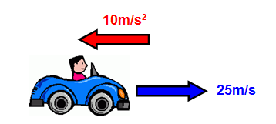
Acceleration
Suppose a car is travelling in a certain direction at a velocity of 25 m/s and starts to experience a constant acceleration of
10 m/s² in the opposite direction.
If we take this direction to be positive,
the car will experience a negative acceleration of −10 m/s².
the car will travel with a positive velocity of 25 m/s.

Slide 11
Acceleration
Suppose a car is travelling in a certain direction at a velocity of 25 m/s and starts to experience a constant acceleration of
10 m/s² in the opposite direction.
However, if we take this direction to be positive instead,
the car will experience a positive acceleration of 10 m/s².
the car will travel with a negative velocity of −25 m/s.

Slide 12
Travelling with Negative Acceleration
If we take “rightwards” as positive in our example, the car will be travelling with a negative acceleration of 10 m/s².
Time (s) | Velocity (m/s)
0 | 25
1 | 15
2 | 5
Time (s) | Velocity (m/s)
0 | 25
The initial velocity is 25 m/s.
Time (s) | Velocity (m/s)
2 | 5
3 | −5
4 | −15
5 | −25
In every second, the speed reduces by 10m/s.
These negative values mean that the car is now travelling in the opposite direction, i.e. “leftwards”.
The numbers indicate whether the car is moving fast or slow.

Slide 13
Graphs: Velocity to Acceleration
If the graph is a straight sloping line, then a constant rate of change is observed.
v (m/s)
The gradient at a point on the velocity against time graph is the instantaneous acceleration at that point.
Since the gradient of the graph, m, is the same at any point of time, we get a horizontal straight line on the acceleration against time graph.
Gradient = m
Gradient = m
0
t (s)
a (m/s²)
m
0
t (s)

Slide 14
Graphs: Velocity to Acceleration
v (m/s)
v (m/s)
Velocity-time graph
Velocity-time graph
Gradient = a₄
Gradient = a₄
Gradient = a₃
Gradient = a₃
Gradient = a₂
Gradient = a₂
Gradient = a₁
Gradient = a₁
0
t₁
t₂
t₃
t₄
t (s)
0
t₁
t₂
t₃
t₄
t (s)
Possible acceleration-time graphs as the gradient of the velocity-time graph increases.
a (m/s²)
a (m/s²)
Acceleration-time graph
a₄
Acceleration-time graph
a₄
a₃
a₂
a₃
a₁
a₂
a₁
0
t₁
t₂
t₃
t₄
0
t₁
t₂
t₃
t₄
t (s)
t (s)

Slide 15
Quantity versus Rate of change of Quantity
Rate of change of Quantity
Rate of change-time graph
Finding the area under the rate of change-time curve
Quantity-time curve
Rate of change curve
Finding the gradient of the quantity-time curve
A
B
C
D
0
t
t (s)
Quantity
A + B + C + D
A + B + C
A + B
Quantity-time graph
A
0
t
t (s)
Quantity | Rate of change of Quantity
Displacement | Velocity
Velocity | Acceleration
The gradient of a quantity-time graph at any particular time t is reflected in the rate of change-time graph.

Slide 16
In summary
Displacement -Time graph
Gradient of
Displacement-time
graph
Area under
Velocity-time
graph
Velocity -Time graph
Gradient of
Velocity-time
graph
Area under
Acceleration-time
graph
Acceleration -Time graph

Slide 17
In summary
The following table shows an overview of each vector quantity and the interpretation of its associated positive and negative values using the common convention.
Quantity | Positive value | Negative value
Displacement | Object lies on the right side of the reference point | Object lies on the left side of the reference point
Velocity | Object is moving towards the right | Object is moving towards the left
Acceleration | Increasing speed when moving towards the right, or Reducing speed when moving towards the left | Reducing speed when moving towards the right, or Increasing speed when moving towards the left
Notes:
Added: “using the common convention”

Slide 18
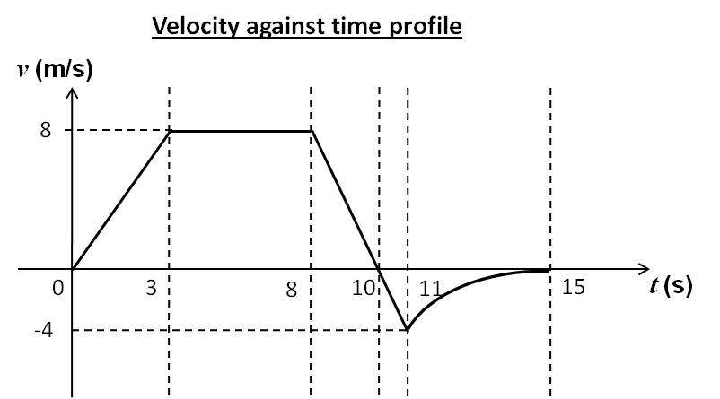
Velocity profile analysis – phase 1
Phase 4
Phase 1
Phase 2
Phase 3
Phase 5
The velocity is always positive, which means that the car is moving to the right.
The velocity of the car is increasing at a constant rate (i.e. constant acceleration) with a magnitude of (8 – 0)÷(3 – 0) = 2.67 m/s², rightwards.

Slide 19
Velocity profile analysis – phase 2
Phase 4
Phase 1
Phase 2
Phase 3
Phase 5
The velocity is always positive, which means that the car is moving to the right.
The velocity of the car is constant at 8 m/s (i.e. zero acceleration).

Slide 20
Velocity profile analysis – phase 3
Phase 4
Phase 1
Phase 2
Phase 3
Phase 5
The velocity changes from positive to 0 m/s, which means that the car is moving to the right and stopping momentarily at t = 10 s, changing its direction of travel.
Rate of change of velocity = (0 − 8) ÷ (10 − 8) = - 4 m/s²
This indicates a reducing speed with the car moving towards the right.

Slide 21
Velocity profile analysis – phase 4
Phase 4
Phase 1
Phase 2
Phase 3
Phase 5
The velocity changes from 0 m/s to negative, which means that the car is moving from its momentarily rest at t = 10 s to the left.
Rate of change of velocity = (- 4 – 0) ÷ (11 − 10) = - 4 m/s²
This indicates an increasing speed with the car moving towards the left.

Slide 22
Velocity profile analysis – phase 5
Phase 4
Phase 1
Phase 2
Phase 3
Phase 5
The velocity changes from negative to zero, which means that the car is moving to the left until it comes to a stop at t = 15 s.
The velocity of the car is increasing at a decreasing rate (decreasing acceleration).

Slide 23
Characteristics of graphs
The following characteristics are considered in the respective time intervals when choosing the correct sketches:
Gradient
Area under graph
Values indicated on axes

Slide 24
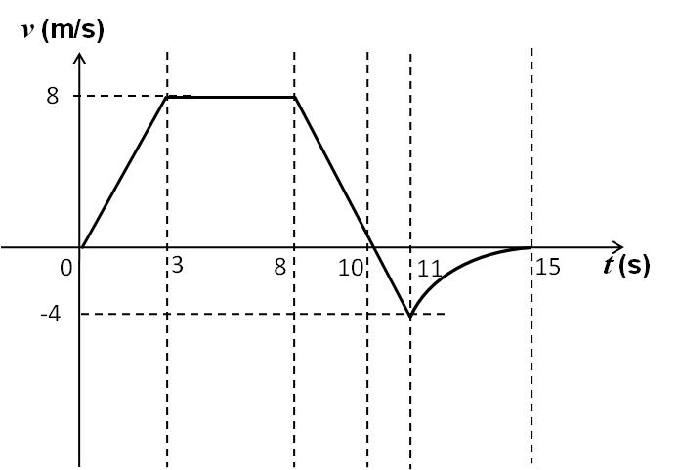
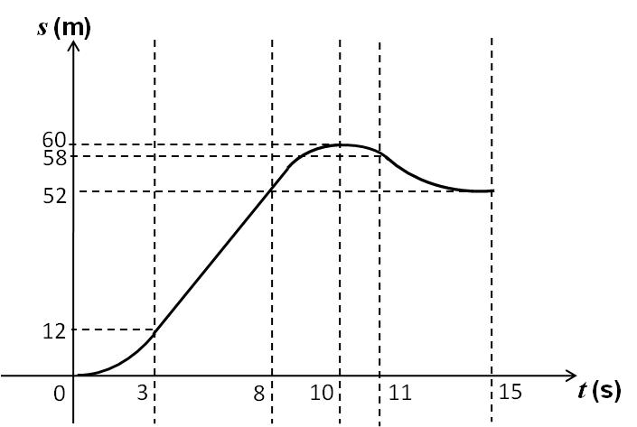
Correct displacement-time sketch
Phase 1:
Change in displacement
= area of filled triangle
= 0.5 × (3 − 0) × (8 − 0)
= 12 m
Value on x-axis
= 0 + 12
= 12 m
Shape of x-t graph:
Since the magnitude of velocity is increasing at a constant rate, the shape of the displacement-time graph in this interval should be a curve with an increasing gradient.
x
Phase 2
Phase 4
Phase 1
Phase 3
Phase 5

Slide 25
Correct displacement-time sketch
Phase 2:
Change in displacement
= area of filled rectangle
= (8 − 3) × (8 − 0)
= 40 m
Value on x-axis
= 0 + 12 + 40
= 52 m
Shape of x-t graph:
Since the magnitude of velocity is kept at a constant value of 8 m/s, the shape of the displacement-time graph in this interval should be a straight sloping line with a gradient of 8.
x
Phase 2
Phase 4
Phase 1
Phase 3
Phase 5

Slide 26
Correct displacement-time sketch
Phase 3:
Change in displacement
= area of filled triangle
= 0.5 × (10 − 8) × (8 − 0)
= 8 m
Value on x-axis
= 0 + 12 + 40 + 8
= 60 m
Shape of x-t graph:
Since the magnitude of velocity is decreasing at a constant rate to zero, the shape of the displacement-time graph in this interval should be a curve with a gradient which decreases to zero.
x
Phase 2
Phase 4
Phase 1
Phase 3
Phase 5

Slide 27
Correct displacement-time sketch
Phase 4:
Change in displacement
= area of filled triangle
= 0.5 × (11 − 10) × (−4 − 0)
= −2 m
Value on x-axis
= 0 + 12 + 40 + 8 − 2
= 58 m
Shape of x-t graph:
Since the magnitude of velocity is increasing at a constant rate, the shape of the displacement-time graph in this interval should be a curve with an increasing gradient.
x
Phase 2
Phase 4
Phase 1
Phase 3
Phase 5

Slide 28
Correct displacement-time sketch
Phase 5:
Change in displacement
< area of blue triangle
= 0.5 × (15 − 11) × (−4 − 0)
= −8 m which can possibly be −6 m
Value on x-axis
= 0 + 12 + 40 + 8 − 2 − 6
= 52 m
Shape of x-t graph:
Since the magnitude of velocity is decreasing to zero, the shape of the displacement-time graph in this interval should be a curve with a gradient which decreases to zero.
x
Phase 2
Phase 4
Phase 1
Phase 3
Phase 5

Slide 29
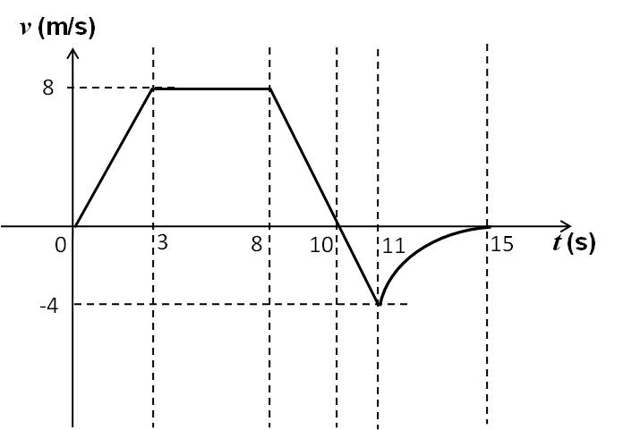
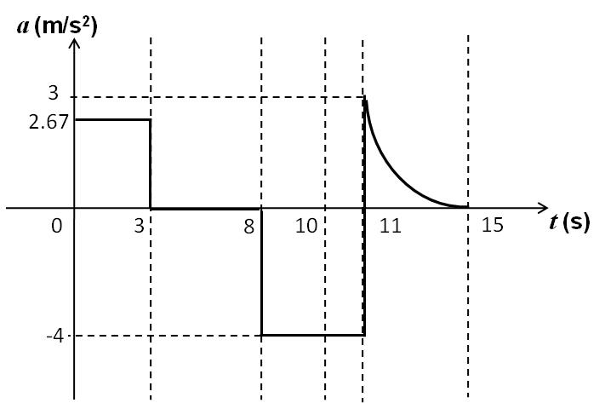
Correct acceleration-time sketch
Phase 1:
Value on a-axis
= gradient of v-t graph
= (8 − 0) ÷ (3 − 0)
≈ 2.67 m/s²
Shape of a-t graph:
Since the gradient of the velocity-time graph in this time interval has a constant value of 2.67 m/s² (i.e. constant acceleration), the shape of the acceleration-time graph in this interval should be a horizontal straight line.
Phase 2
Phase 4
Phase 1
Phase 3
Phase 5

Slide 30
Correct acceleration-time sketch
Phase 2:
Value on a-axis
= gradient of v-t graph
= (8 − 8) ÷ (8 − 3) = 0 m/s²
Shape of a-t graph:
Since the gradient of the velocity-time graph in this time interval has a constant value of 0 m/s² (i.e. zero acceleration), the shape of the acceleration-time graph in this interval should be a horizontal straight line.
Phase 2
Phase 4
Phase 1
Phase 3
Phase 5

Slide 31
Correct acceleration-time sketch
Phases 3 and 4:
Value on a-axis
= gradient of v-t graph
= (−4 − 8) ÷ (11 − 8) = −4 m/s²
Shape of a-t graph:
Since the gradient of the velocity-time graph in this time interval has a constant value of −4 m/s² (i.e. constant acceleration), the shape of the acceleration-time graph in this interval should be a horizontal straight line.
Phase 2
Phase 4
Phase 1
Phase 3
Phase 5

Slide 32
Correct acceleration-time sketch
Phase 5:
Value on a-axis
= gradient of v-t graph, which is decreasing by comparing the two blue triangles.
Shape of a-t graph:
Since the gradient of the velocity-time graph in this time interval is decreasing (i.e. decreasing acceleration), assuming a decreasing rate of decrease in gradient (i.e. velocity), the shape of the acceleration-time graph in this interval would be a curve with decreasing gradient.
Phase 2
Phase 4
Phase 1
Phase 3
Phase 5

Slide 33
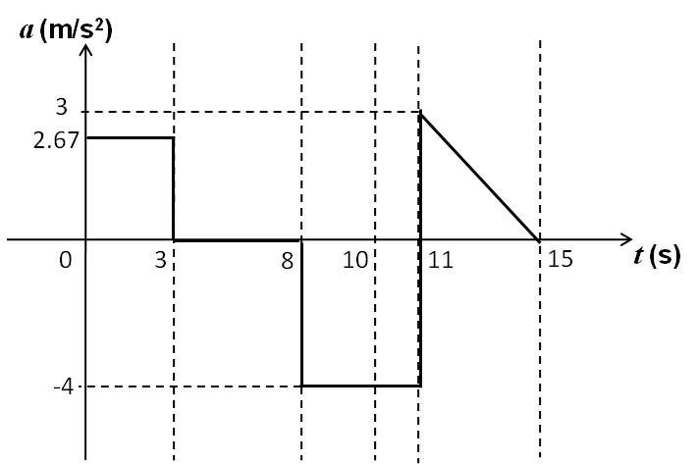
Anne versus Betty
Betty’s sketch
The difference between Anne’s and Betty’s acceleration-time sketches is in phase 5.
Phase 5:
Shape of a-t graph:
Since the gradient of the velocity-time graph in this time interval is decreasing (i.e. decreasing acceleration), assuming a constant rate of decrease in gradient (i.e. velocity), the shape of the acceleration-time graph in this interval could also be a sloping straight line.
Thus, at first glance, the shape of Anne’s sketch is possibly a correct sketch.
Phase 2
Phase 4
Anne’s sketch
Phase 1
Phase 3
Phase 5

Slide 34
Anne’s acceleration-time sketch
Phase 5:
Change in velocity
= area of filled triangle
= 0.5 × (15 − 11) × (3 − 0)
= 6 m/s
Value on v-axis at time t = 15 s
= − 4 + 6
= 2 m/s
≠ 0 m/s
Since Anne’s sketch results in an incorrect computed value on the
v-axis, Anne’s sketch is incorrect.
Phase 2
Phase 4
Anne’s sketch
Phase 1
Phase 3
Phase 5

Slide 35
Betty’s acceleration-time sketch
Phase 5:
Change in velocity
< area of green triangle
= 0.5 × (15 − 11) × (3 − 0)
= 6 which can possibly be 4 m/s
Value on v-axis at time t = 15 s
= − 4 + 4 = 0 m/s
Thus, Betty’s sketch is a possible correct acceleration-time sketch for the given velocity-time profile.
Phase 2
Phase 4
Betty’s sketch
Phase 1
Phase 3
Phase 5

Slide 36
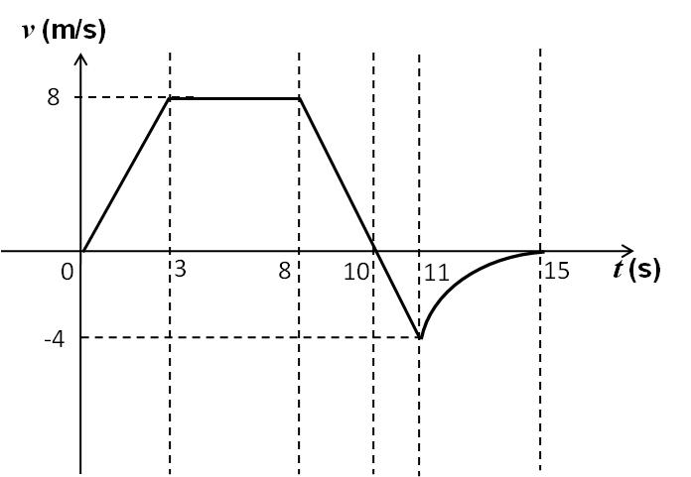
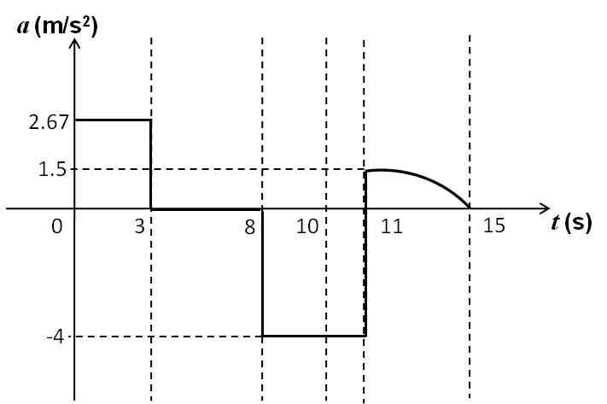
Going further – Cynthia’s sketch
The gradient value in the first four phases of the v-t graph are all fixed at one value. Only phase 5 comprises of a curve with decreasing gradient.
Phase 5:
Shape of a-t graph:
Since the gradient of the velocity-time graph in this time interval is decreasing (i.e. decreasing acceleration), assuming an increasing rate of decrease in gradient (i.e. velocity), the shape of the acceleration-time graph in this interval could also be a curve with increasing gradient.
Phase 2
Phase 4
Cynthia’s sketch
Phase 1
Phase 3
Phase 5

Slide 37
Going further – Cynthia’s sketch
Phase 5:
Change in velocity
> area of green triangle
= 0.5 × (15 − 11) × (1.5 − 0)
= 3
Change in velocity
< area of orange rectangle
= (15 − 11) × (1.5 − 0)
= 6
Therefore, change in velocity is greater than 3 and smaller than 6 which can possibly be 4 m/s
Value on v-axis at time t = 15 s
= − 4 + 4
= 0 m/s
Phase 2
Phase 4
Cynthia’s sketch
Phase 1
Phase 3
Phase 5

Slide 38
Learning points
Speed and velocity are not the same. Velocity can be positive or negative depending on the direction of movement with respect to the reference direction.
Distance and displacement are not the same. Displacement can be positive or negative depending on the position of the object from the reference point.
Average acceleration is the change in velocity per unit time whereas average velocity is the change in displacement per unit time.
Based on the relationships, graphs of displacement, velocity and acceleration against time can be plotted and derived from one another.

Slide 39
Discussion
At a certain time, Train A starts moving with a velocity of 100 km/h and a constant acceleration of 10 m/s² whereas Train B starts moving with a velocity of 250 km/h and a constant acceleration of -10 m/s².
Which train will reach a velocity of 150 km/h first?

