Slide 1
A101 Science
Problem 07: Drive and Flow
6th Presentation
Copyright © 2010

Slide 2
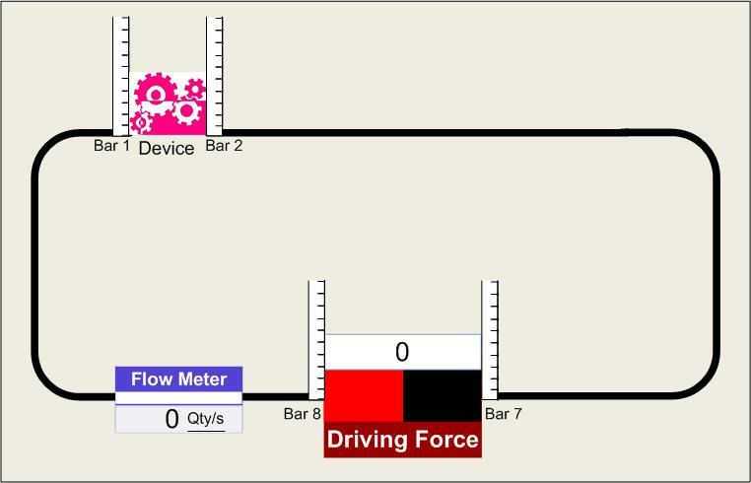
Arrangement1.exe with one device
Observations
When there is no driving force, there is no flow around the path.

Slide 3
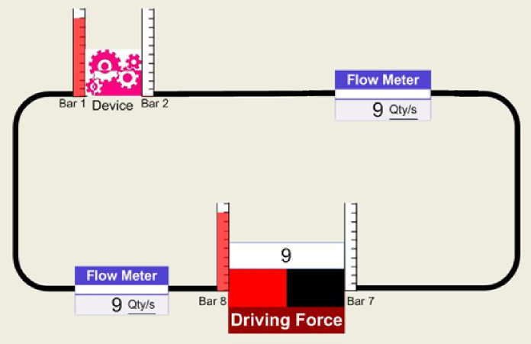
Arrangement1.exe with one device
Observations
Left bar is higher
than the right bar.
Same height
Same height
Clockwise flow
The difference in bar heights is greater if the driving force is more positive.

Slide 4
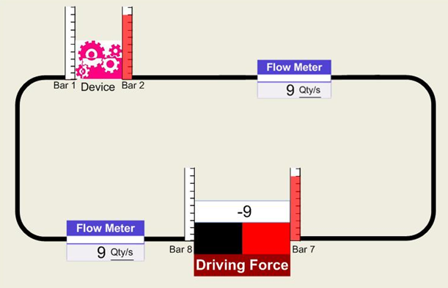
Arrangement1.exe with one device
Observations
Right bar is higher
Same height
Same height
Right bar is higher
Anticlockwise flow
The difference in bar heights is greater if the driving force is more negative.

Slide 5
Arrangement1.exe with one device
Deductions
The difference in bar height both across the driver and across the device are equal (in magnitude) to the driving force.
The amount of flow is equal (in magnitude) to the driving force.
Hence, this also means the amount of flow is equal (in magnitude) to the difference in bar height across the driver or across the device.
The direction of the flow is dependent on the sign of the driving force.
Notes:
5

Slide 6
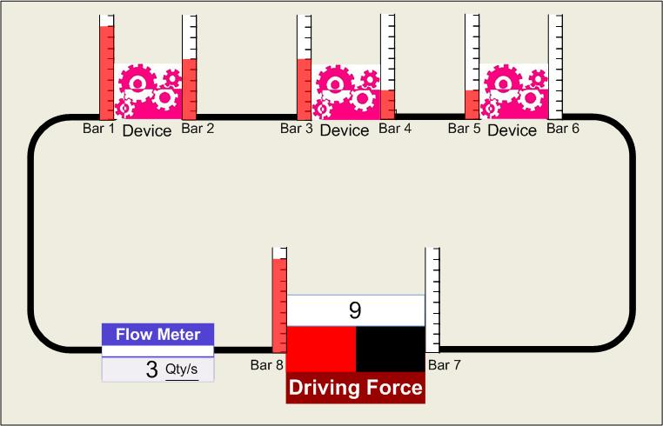
Arrangement1.exe with three devices
Observations and Deductions
As the driving force increases in magnitude, the difference in bar height across the device and the driver increases.
The difference in bar height across the driver is equal (in magnitude) to the driving force.
The difference in bar height across each device is equal.
The sum of the differences in bar heights across the devices is equal to the difference in bar height across the driver.
The amount of flow is equal (in magnitude) to the difference in bar height across each device.
9 units
Clockwise flow
In the case of the programs, the proportionality constant is 1.
Notes:
6

Slide 7
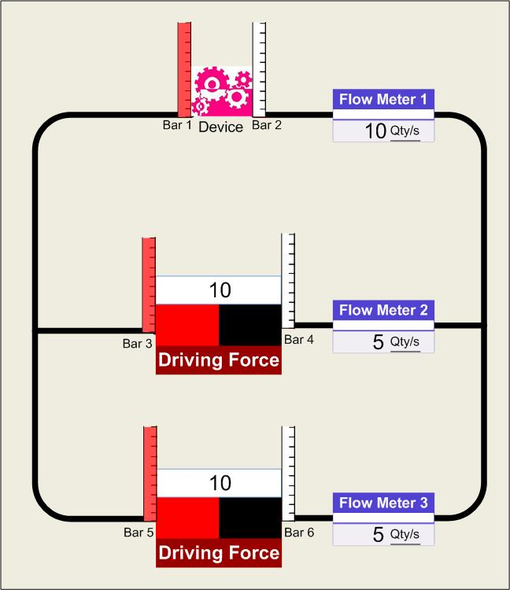
Arrangement2.exe with two drivers
Observations and Deductions
The addition of the second driving force has no influence on the height of the bars across the device and hence the flow through the device remains the same.
The flow through each driver is halved compared to the case with only one driver since two drivers are now providing for the same flow through the device.
The flow follows the arrows indicated as the sum of the flow through the two drivers is equal to the flow through the device.
Notes:
7

Slide 8
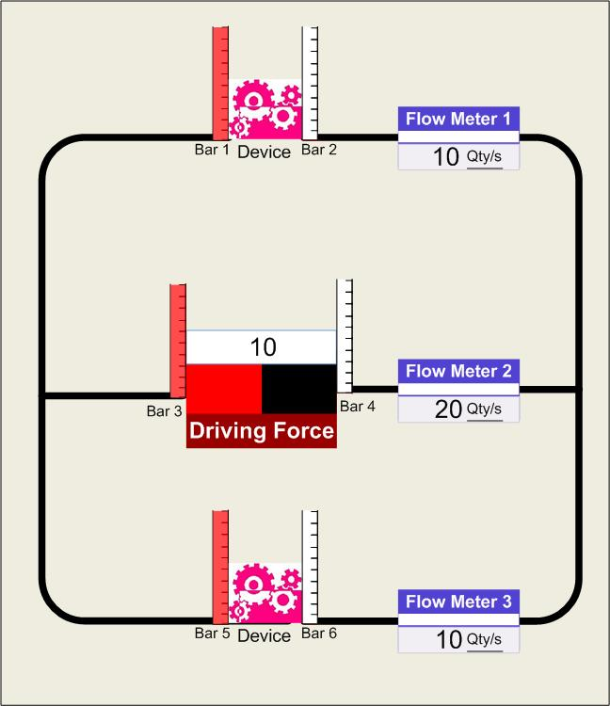
Arrangement2.exe with two devices
Observations and Deductions
The addition of the second device has no influence on the bar heights across the first device and hence the flow through the first device remains the same.
The flow through both devices is the same since the difference in bar height across both devices is the same.
The flow through the driving force is doubled since it has to provide the flow through both devices now.
The flow follows the arrows indicated as the sum of the flows through the devices is equal to the flow through the driver.
Notes:
8

Slide 9
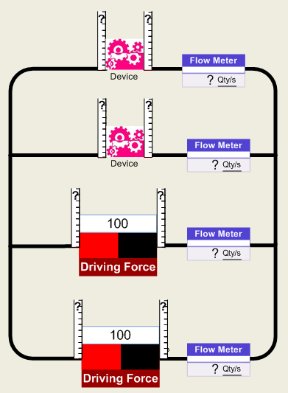
Making predictions
  In the arrangement shown, we observe that the driving force supplied by each driver is 100 units.
  Hence, the difference in bar height across each driver is 100 units, with the height of the bar to the left of each driver being 100 units.
  From Arrangement2.exe, whether adding a device or a driver to the circuit consisting of one device and one driver in the given manner has no effect on the difference in bar height across and the flow through the device.
  Hence, like in the case of having one device and one driver, the difference in bar height across the device equals to the difference in bar height across the driver.
  The flow through each device is 100 Qty/s.
100
0
100 Qty/s
100
0
100 Qty/s
100
0
100
0
Notes:
9

Slide 10
Making predictions
100
0
  As the total flow through the devices is equal to the total flow through the drivers, the flow through each driver must be 100 Qty/s.
100 Qty/s
100
0
100 Qty/s
100
0
100 Qty/s
100
0
100 Qty/s
Notes:
10

Slide 11
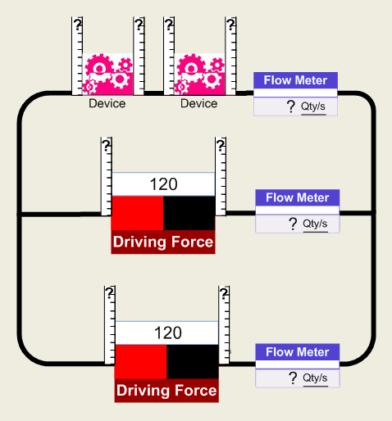
Making predictions
Since the driving force is 120 units, the difference in bar height across the driver is 120 units, with the height of the left bar being 120 units.
The sum of the difference in bar heights across the two devices is equal to the difference in bar height across the driver. Dividing equally, the difference in bar height across each device is 60 units.
Hence, the flow through the device is 60 Qty/s.
The flow through each driver must be 30 Qty/s.
A
120
60
60
0
60 Qty/s
120
0
30 Qty/s
120
0
30 Qty/s
Notes:
11

Slide 12
Learning points
To explain the phenomena observed in the programs, we performed the steps similar to A101 P02 Strange Actions.
Observations
Deductions
Prediction
The driver provides a difference in a quantity (bar height) across the device which results in a flow.
The device(s) cause(s) a drop in the quantity (bar height) in the direction of the flow set up by the driver.
The amount of flow is directly proportional to the difference in that quantity but inversely proportional to the number of devices.
The total amount of flow through all devices must equal to the total amount of flow through all the drivers. When there is a branching of paths, the amount of flow before the branching must be equal to the total flow after the branching.
Different arrangements of the same number of drivers and devices will not necessarily give the same outcome.

Slide 13
Linking to real life
All the observations and conclusions so far can be also observed in daily life scenarios:
  A potential difference causes a current to flow in an electrical circuit.
  A temperature difference causes heat to flow from a hot region to a cold region via conduction.
  A pressure difference causes air to flow from a region of high pressure to a region of low pressure.
Notes:
13

Slide 14

Discussion
Determine the amount of flow through the driver in each of the following arrangements.
a)
b)
10
30
c)
d)
20
5

